Slide 1
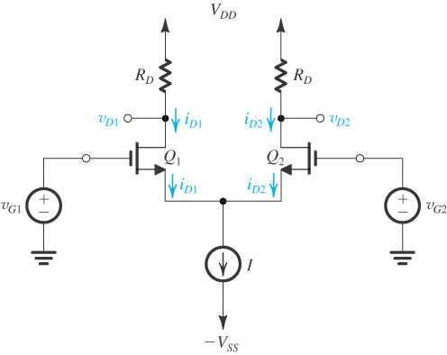
MOS Differential Amplifiers
Fig.: MOS differential-pair configuration.
Two matched transistors (Q₁ and Q₂) joined and biased by a constant current source I.
FET’s should not enter triode region of operation.
Figure: The basic MOS differential-pair configuration.

Slide 2
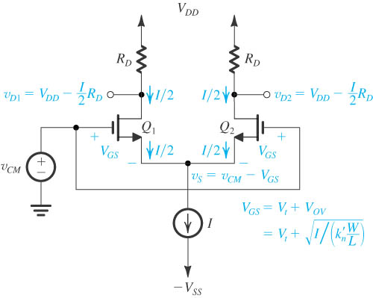
Operation with a Common –Mode Input Voltage
Consider case when two gate terminals are joined together.
Connected to a common-mode voltage (V_{CM}).
v_{G1} = v_{G2} = V_{CM}
Q₁ and Q₂ are matched.
Current I will divide equally between the two transistors.
I_{D1} = I_{D2} = I/2, V_{S} = V_{CM} – V_{GS}
where V_{GS} is the gate-to-source voltage.

Slide 3
Operation with a Common –Mode Input Voltage
Equations (8.2) through (8.8) describe this system, if channel-length modulation is neglected.
Note specification of input common-mode range (V_{CM}).
(Use V_{DS}≥V_{ov})
V_{CS}: Voltage across the current souce
(Use V_{CM}≥V_{S}+V_{GS})

Slide 4
Operation with a Common –Mode Input Voltage
Symmetry circuit.
Common-mode voltage.
Current I divides equally between two transistors.
The difference between two drains is zero (v_{D2} – v_{D1})=0
The differential pair rejects the common-mode input signals

Slide 5
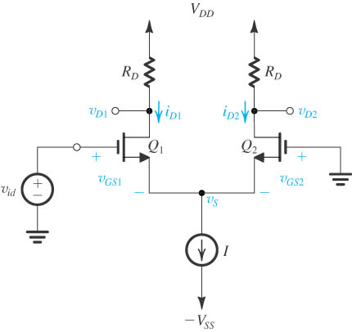
Operation with a Differential Input Voltage
The MOS differential pair with a differential input signal v_{id} applied.
With v_{id} positive: v_{GS1} > v_{GS2}, i_{D1} > i_{D2}, and v_{D1} < v_{D2}; thus (v_{D2} − v_{D1}) will be positive.
With v_{id} negative: v_{GS1} < v_{GS2}, i_{D1} < i_{D2}, and v_{D1} > v_{D2}; thus (v_{D2} − v_{D1}) will be negative.
The differential pair responds to a difference-mode or differential input signals.

Slide 6

Operation with a Differential Input Voltage
At this point, it is useful to inquire about the value of v_{id} that causes the entire bias current I to flow in one of the two transistors. In the positive direction, this happens when v_{GS1} reaches the value that corresponds to i_{D1} = I, and v_{GS2} is reduced to a value equal to the threshold voltage V_{t} , at which point v_{S} = –V_{t} . The value of v_{GS1} can be found from
(v_{GS1} – V_{t} = v_{id})
Figure: The MOS differential pair with a differential input signal v_{id} applied.

Slide 7
Operation with a Differential Input Voltage
Differential input voltage.
Response to the differential input signal.
The current I can be steered from one MOS to the other by varying the differential input voltage in the range:
When differential input voltage is very small, the differential output voltage is proportional to it, and the gain is high.

Slide 8
Small-Signal Operation of MOS Differential Pair
Linear amplifier
Differential gain
Common-mode gain
Common-mode rejection ratio(CMRR)
Mismatch on CMRR

Slide 9
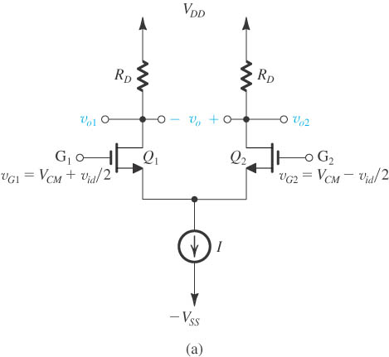
Differential Gain
a common-mode voltage applied to set the dc bias voltage at the gates.
v_{id} applied in a complementary (or balanced) manner.

Slide 10
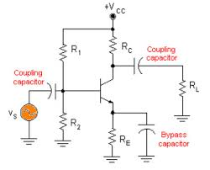
Differential Gain
Two reasons single-ended amplifiers are preferable:
Insensitive to interference.
Do not need bypass coupling capacitors.

Slide 11
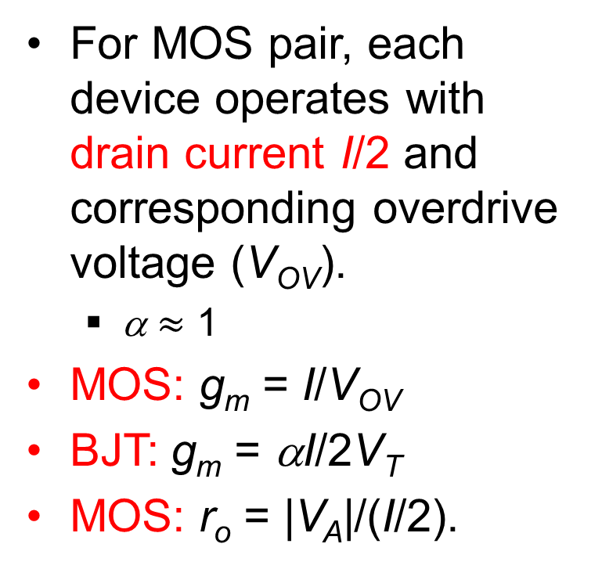
Differential Gain
For MOS pair, each device operates with drain current I/2 and corresponding overdrive voltage (V_{OV}).
α $≈$ 1
MOS: g_{m} = I/V_{OV}
BJT: g_{m} = αI/2V_{T}
MOS: r_{o} = |V_{A}|/(I/2).

Slide 12
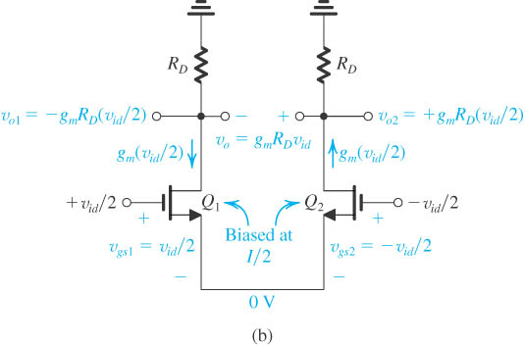
Differential Gain
Signal voltage at the joint source connection must be zero.

Slide 13
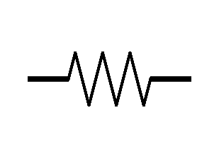
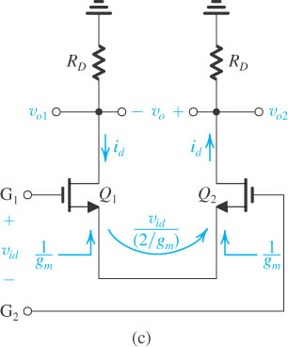
Differential Gain
V_{s} = 0
i_{d}
-i_{d}
ground
An alternative way of looking at the small-signal operation of the circuit.

Slide 14
Differential Gain
Differential gain
Output taken single-ended
Output taken differentially
Advantages of output signal taken differentially
Reject common-mode signal
Increase in gain by a factor of 2(6dB)

Slide 15
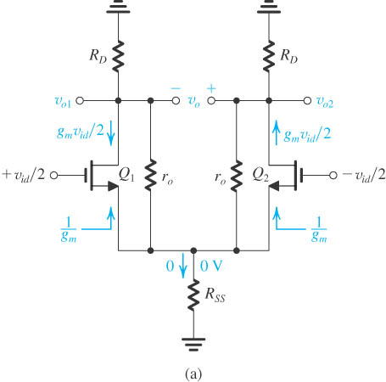
Differential Gain
MOS differential amplifier with r_{o} and R_{SS} taken into account.

Slide 16
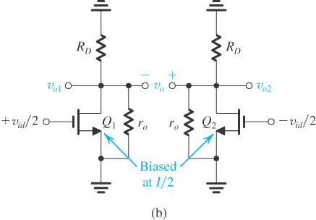
Differential Gain
Equivalent circuit for determining the differential gain.
Each of the two halves of the differential amplifier circuit is a common-source amplifier, known as its differential “half-circuit.”

Slide 17
Differential Gain
Differential gain
Output taken single-ended
Output taken differentially

Slide 18
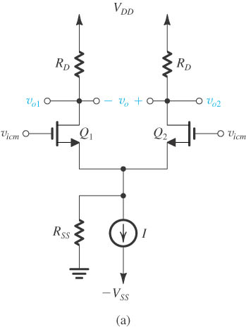
Common-Mode Gain
The MOS differential amplifier with a common-mode input signal v_{icm}.

Slide 19
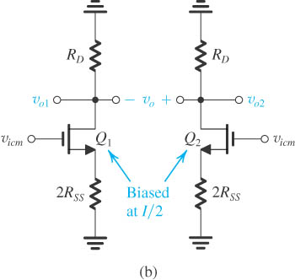
Common-Mode Gain
Equivalent circuit for determining the common-mode gain (with r_{o} ignored).
Each half of the circuit is known as the “common-mode half-circuit.”

Slide 20
Common-Mode Gain
Common-mode gain
Output taken single-ended
Output taken differentially
Total resistance in Drain circuit
Total resistance in Source circuit

Slide 21
Common-Mode Rejection Ratio
Common-mode rejection ratio(CMRR)
Output taken single-ended
Output taken differentially
This is true only when the circuit is perfectly matched.

Slide 22
Biasing in Integrated Circuits
Design Philosophy of Integrated Circuits
Strive to realize as many of the functions required as possible using MOS transistors only.
Large even moderate value resistors are to be avoided
Constant-current sources are readily available.
Coupling and bypass capacitors are not available to be used, except for external use.

Slide 23
Biasing in Integrated Circuits
Design Philosophy of Integrated Circuits
Low-voltage operation can help to reduce power dissipation but poses a host of challenges to the circuit design.
Bipolar integrated circuits still offer many exciting opportunities to the analog design engineer.

Slide 24
Biasing mechanism for ICs
BJT Circuits
The basic BJT current source
Current-steering
MOSFET Circuits
The basic MOSFET current source
MOS current-steering circuits

Slide 25
Biasing mechanism for ICs(cont’d)
Current-mirror circuits with improved performance
A bipolar mirror with base-current compensation
The wilson current mirror
The current steering circuits
The widlar current source

Slide 26
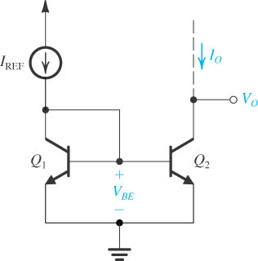
The Basic BJT Current Mirror

Slide 27
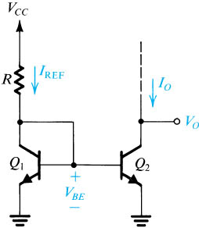
A Simple BJT Current Source.
(simplified if 2/β<<1)
Disadvantages: Decreasing Io, increasing R

Slide 28
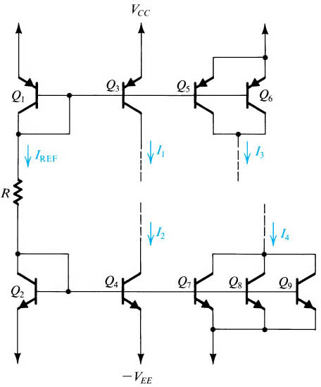
Current Steering

Slide 29
Current-Mirror Circuits with Improved Performance
Two performance parameters need to be improved:
The accuracy of the current transfer ratio of the mirror.
The output resistance of the current source.

Slide 30
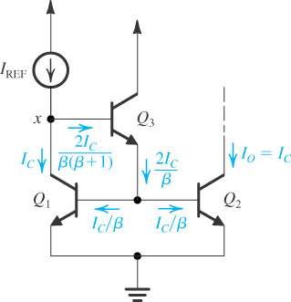
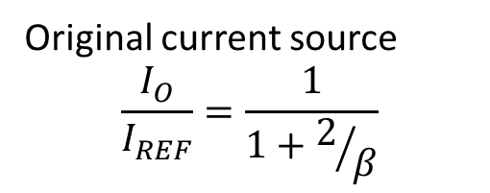
Current Mirror with Base-Current Compensation
Original current source
$$\frac{I_{O}}{I_{REF}}=\frac{1}{1+2/β}$$
Original current source with Base-current compensation

Slide 31
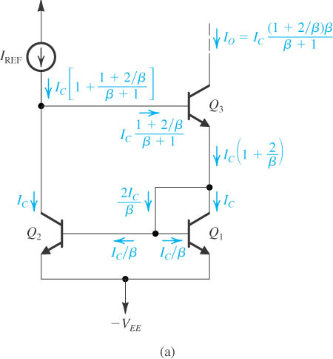
The Wilson Bipolar Current Mirror
(read textbook)

Slide 32
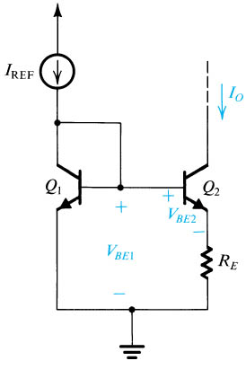

The Widlar Current Source
$$I=I_{S}e^{V_{BE}/V_{T}}$$
(From I_{REF} and I_{o}, determine R_{E})

Slide 33
The advantages of Widlar Current Source
Example6.2 p518
Widlar circuit allows the generation of a small constant current using relatively small resistors( saving in chip area ).
Another important characteristic of the widlar current source is that its output resistance is high.

Slide 34
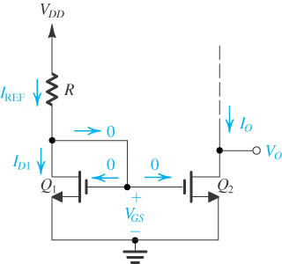
The Basic MOSFET Current Source

Slide 35
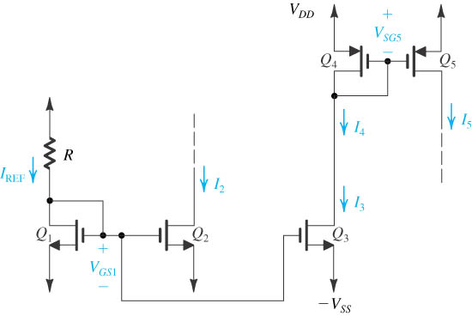
MOS Current-Steering Circuits

Slide 36
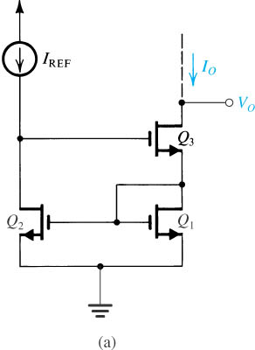
The Wilson MOS Current Mirror

Slide 37
The Differential Amplifier with Active Load
Replace resistance RD with a constant current source results in a much high voltage gain as well as saving in chip area.
Convert the output from differential to single-ended.

Slide 38
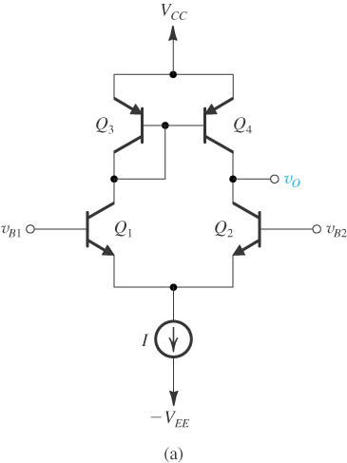
The Bipolar Differential Pair with Active Load
Quiescent analysis:
if the circuit is perfectly matched, no output
Current flows through the output Terminal.
Active-loaded bipolar differential pair.

Slide 39
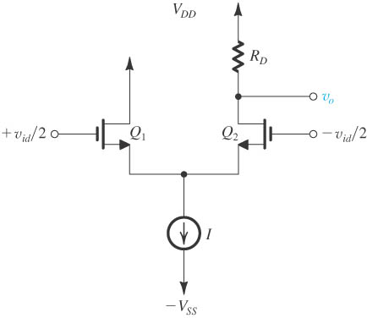
Differential-to-Single-Ended Conversion
Drawback:
Lose a factor of
2(or 6 dB)
A simple but inefficient approach for differential to single-ended conversion.

Slide 40
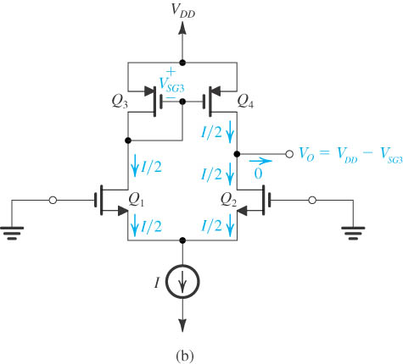
The Active-Loaded MOS Differential Pair
DC analysis: No output current

Slide 41
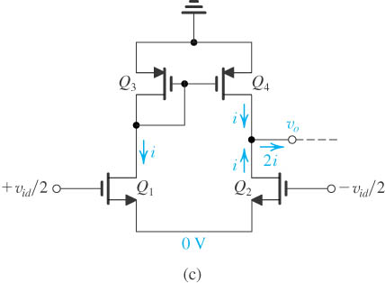
The Active-Loaded MOS Differential Pair
AC analysis: output current is twice
The circuit with a differential input signal applied, neglecting the r_{o} of all transistors.

Slide 42
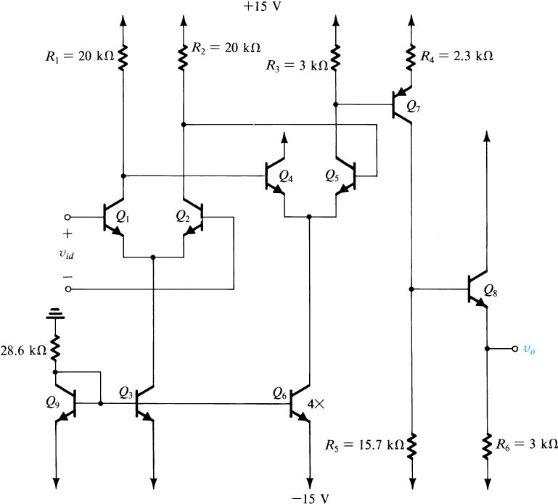
Multistage Amplifiers
The first stage (input stage) is differential-in, differential-out and consists of Q₁ and Q₂.
The second stage is differential-in, single-ended-out amplifier which consists of Q₃ and Q₄.
The third stage is CE amplifier which consists of pnp transistor Q₇ to shifting the dc level.
The last stage is the emitter follower.
Biasing stage.

Slide 43
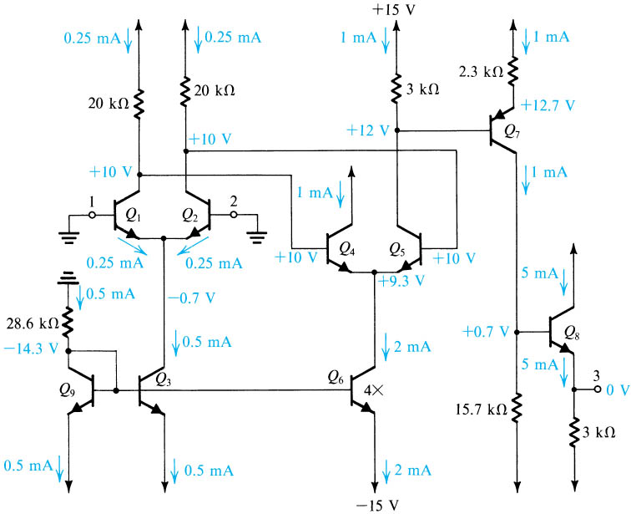

Slide 44
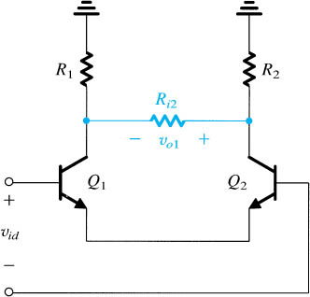
Multistage Amplifier
Equivalent circuit for calculating the gain of the input stage of the example.
Input differential resistance
Gain of first stage

Slide 45
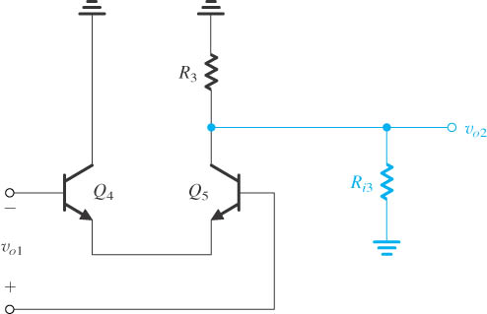
Multistage Amplifier
Equivalent circuit for calculating the gain of the second stage of the example.
Gain of second stage

Slide 46
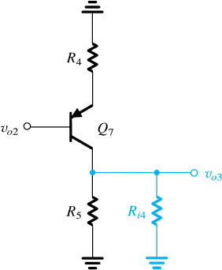
Multistage Amplifier
Equivalent circuit for calculating the gain of the third stage of the example.
Gain of third stage

Slide 47
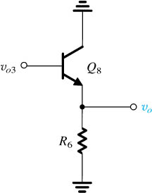
Multistage Amplifier
Equivalent circuit for calculating the gain of the output stage of the example.
Gain of output stage
Output resistance

Slide 48
Summary
The differential-pair or differential-amplifier configuration is most widely used building block in analog IC designs. The input stage of every op-amp is a differential amplifier.
There are two reasons for preferring differential to single-ended amplifiers: 1) differential amplifiers are insensitive to interference and 2) they do not need bypass and coupling capacitors.
For a MOS (bipolar) pair biased by a current source I, each device operates at a drain (collector, assuming α = 1) current of I/2 and a corresponding overdrive voltage V_{OV} (no analog in bipolar). Each device has g_{m}=1/V_{OV} (αI/2V_{T} for bipolar).

Slide 49
Summary
With the two input terminals connected to a suitable dc voltage V_{CM}, the bias current I of a perfectly symmetrical differential pair divides equally between the two transistors of the pair, resulting in zero voltage difference between the two drains (collectors). To steer the current completely to one side of the pair, a difference input voltage v_{id} of at least 2^{1/2}V_{OV} is needed.
Superimposing a differential input signal v_{id} on the dc common-mode input voltage V_{CM} such that v_{I1} = V_{CM} + v_{id}/2 and v_{I2} = V_{CM} – v_{id}/2 causes a virtual signal ground to appear on the common-source (common-emitter) connection.

Slide 50
Summary
The analysis of a differential amplifier to determine differential gain, differential input resistance, frequency response of differential gain, and so on is facilitated by employing the differential half-circuit which is a common-source (common-emitter) transistor biased at I/2.
An input common-mode signal v_{icm} gives rise to drain (collector) voltage signals that are ideally equal and given by –v_{icm}(R_{D}/2R_{SS})[-v_{icm}(R_{C}/2R_{EE}) for the bipolar pair], where R_{SS} (R_{EE}) is the output resistance of the current source that supplies the bias current I.
While the input differential resistance R_{id} of the MOS pair is infinite, that for the bipolar pair is only 2r_{π} but can be increased to 2(β+1)(r_{e}+R_{e}) by including resistances R_{e} in the two emitters. The latter action, however, lowers A_{d}.

